Slide 1
SALES & EVENTS BROCHURE
BARCELONA 2024
COYA 2012 - 2024. All rights reserved.

Slide 2
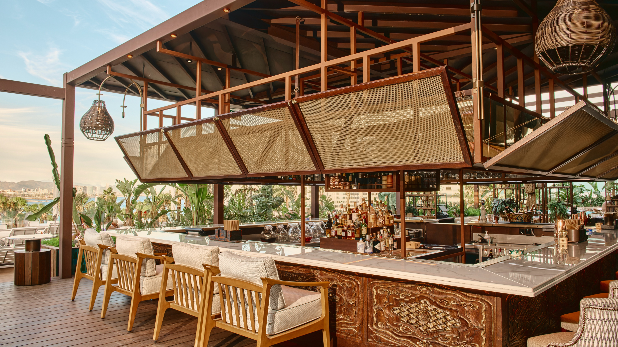
OUR STORY
Born from the spirit of adventure and travel , COYA beckons you into a world of rich flavours,
warm hospitality, and lively cultural experiences.
Nestled in the heart of Mayfair, COYA captures the essence of Peru, bringing together diverse culinary traditions, innovative cocktails and an unforgettable atmosphere with live entertainment, art and unique décor.
VENUE
From the moment you step into our doors, you are taken into a multi-sensory experience: greenery, gold walls & colorful cushions, inherited from the Incan Empire, to the display of our home infused Piscos with COYA MUSIC beats in the background.
COYA is the Queen of the Incas. She brought together a community and made it into a family. We receive our guests with the same generosity, with our design & service combined with the very best of food & drinks.

Slide 3
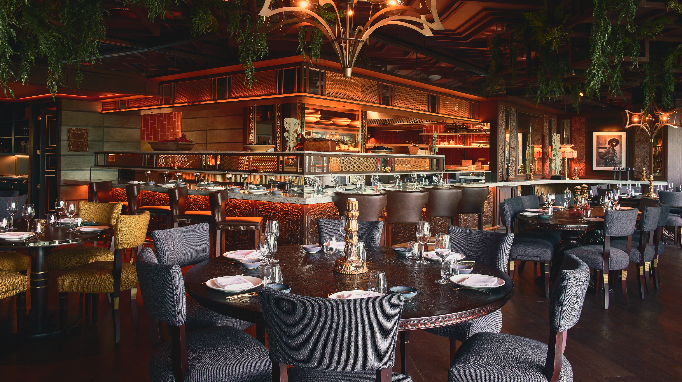
MAIN DINING ROOM
Step into the heart of the dining experience, where vibrant Peruvian culture meets modern sophistication.
Surrounded by rich textures and elegant décor, guests indulge in bold flavors and culinary artistry.
Capacity:
120 seated guests | 150 standing guests

Slide 4
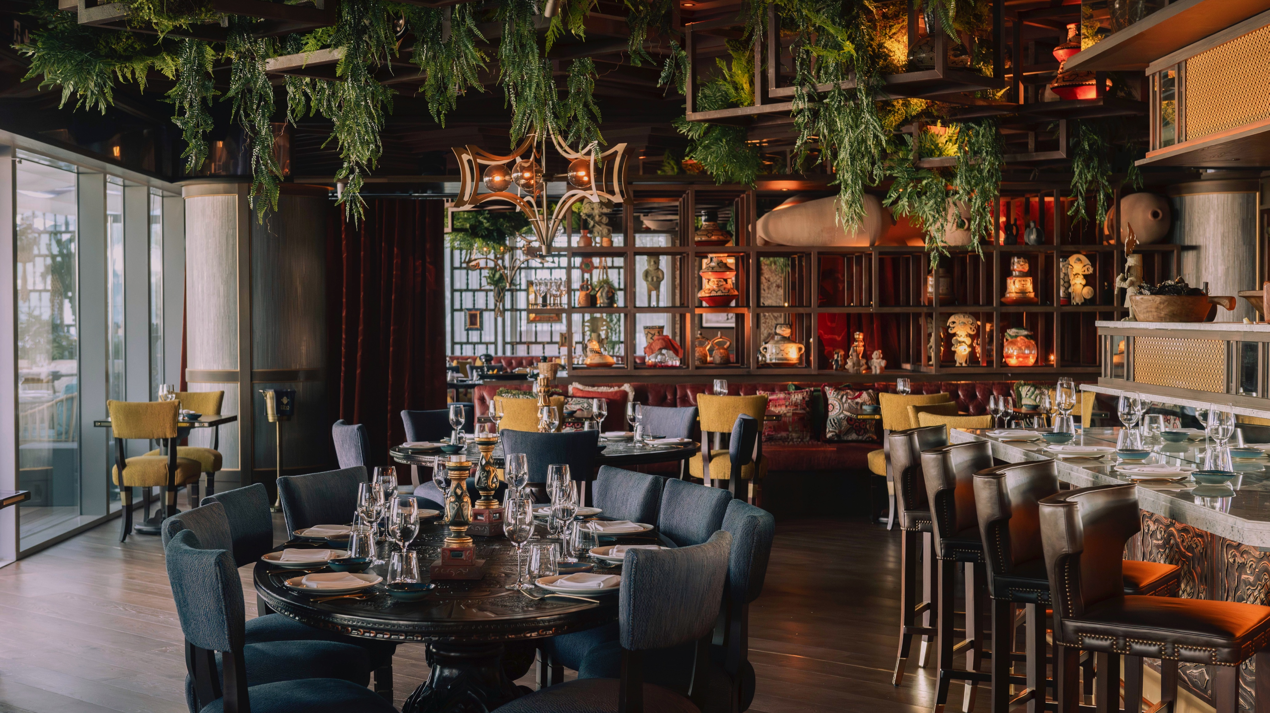
EL DORADO PRIVATE ROOM
El Dorado offers an intimate, golden-hued setting perfect for private gatherings or special celebrations. This exclusive space evokes the mystery and allure of ancient Peru, providing a luxurious escape for memorable moments.
Capacity:
50/60 seated guests

Slide 5
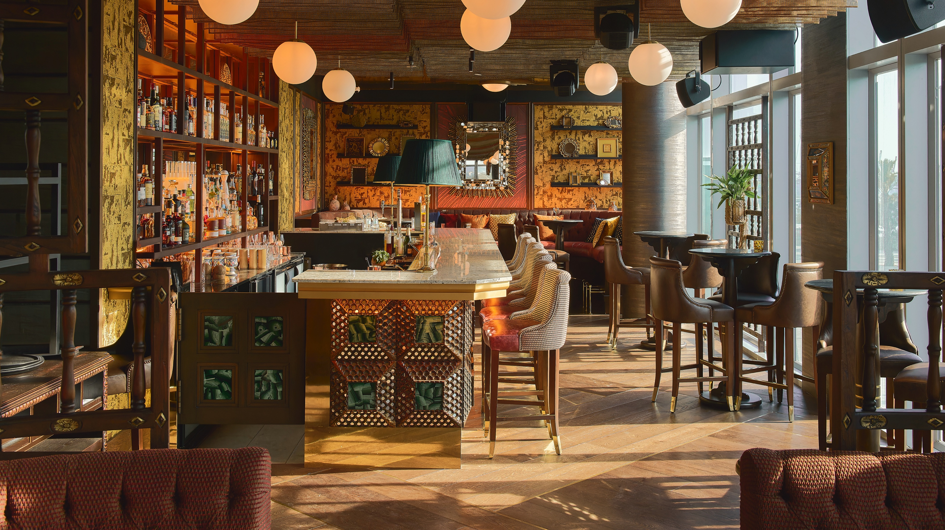
PISCO BAR
Our Pisco Bar offers a menu of expertly crafted cocktails inspired by the spirit of Peru in a lively, social atmosphere.
It’s the perfect spot for mingling, unwinding, or starting an unforgettable evening.
Capacity:
60 seated guests | 120 standing guests

Slide 6
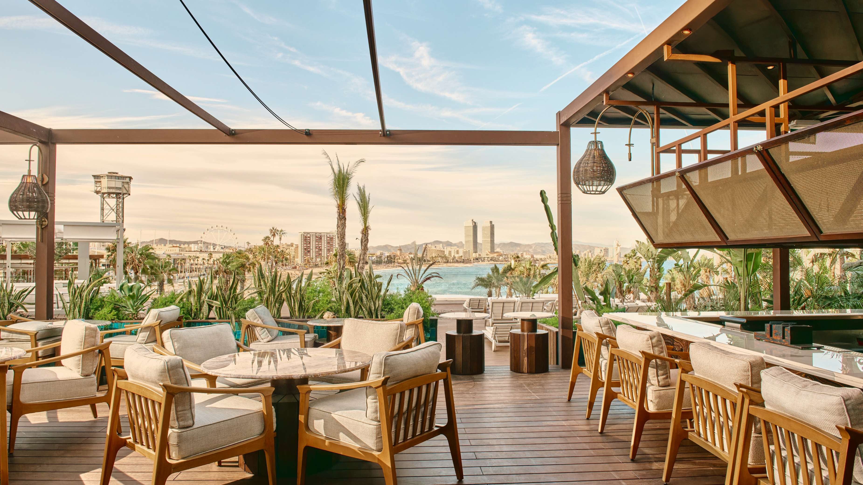
TERRACE
COYA Barcelona’s terrace offers the perfect location for small & large groups and events. The following areas can be hired for Semi-Private and Fully Private events:
Full Terrace Lounge overlooking the ocean
Terrace Bar for drinks by the sea
Terrace VIP Lounge, the best spot for VIP guests
Capacity:
Lounge - 44 seated guests
Main Dining – 80 seated guests | 120 standing guests
Bar – 20 seated guests | 40 standing guests

Slide 7
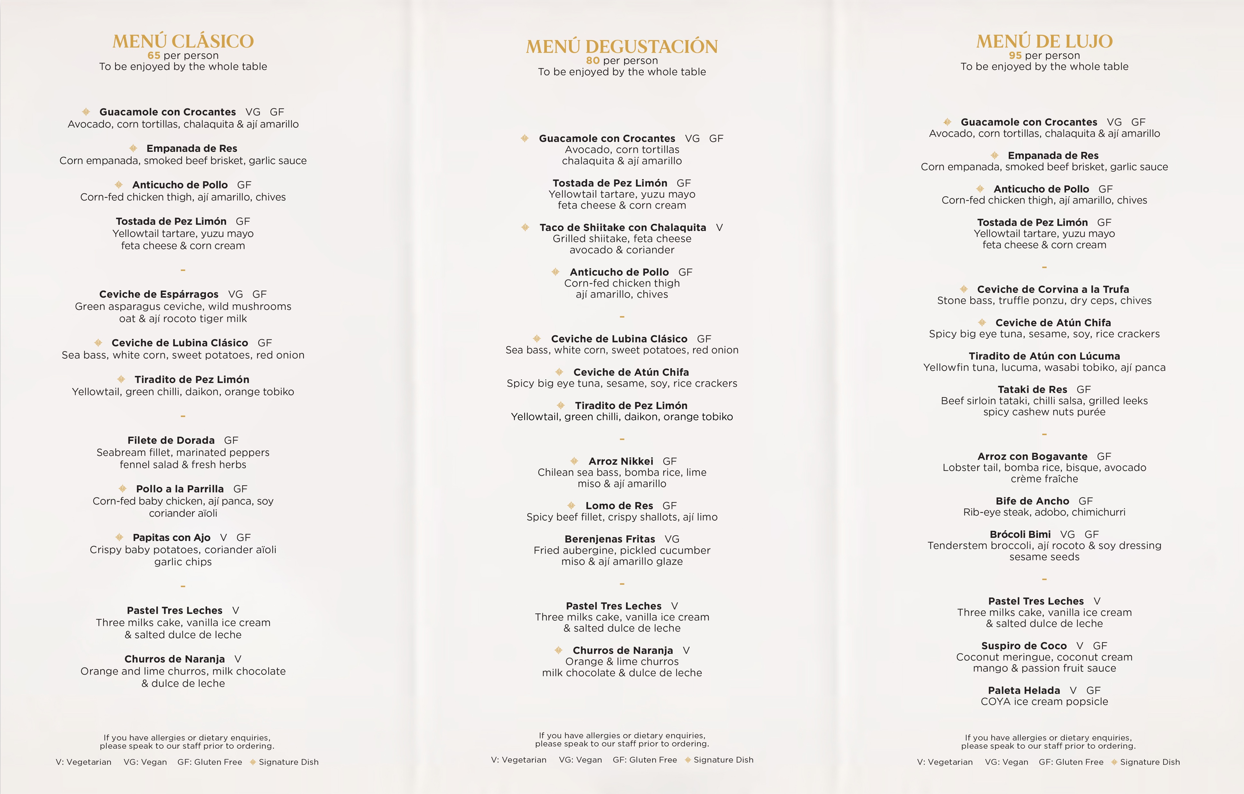
MENUS
COYA 2012 - 2024. All rights reserved.

Slide 8
MENUS
COYA 2012 - 2024. All rights reserved.

Slide 9
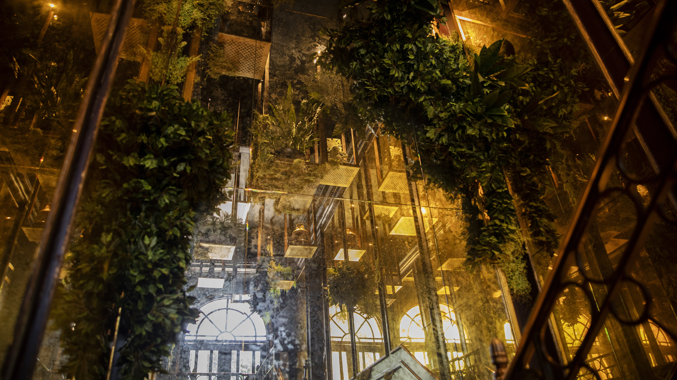
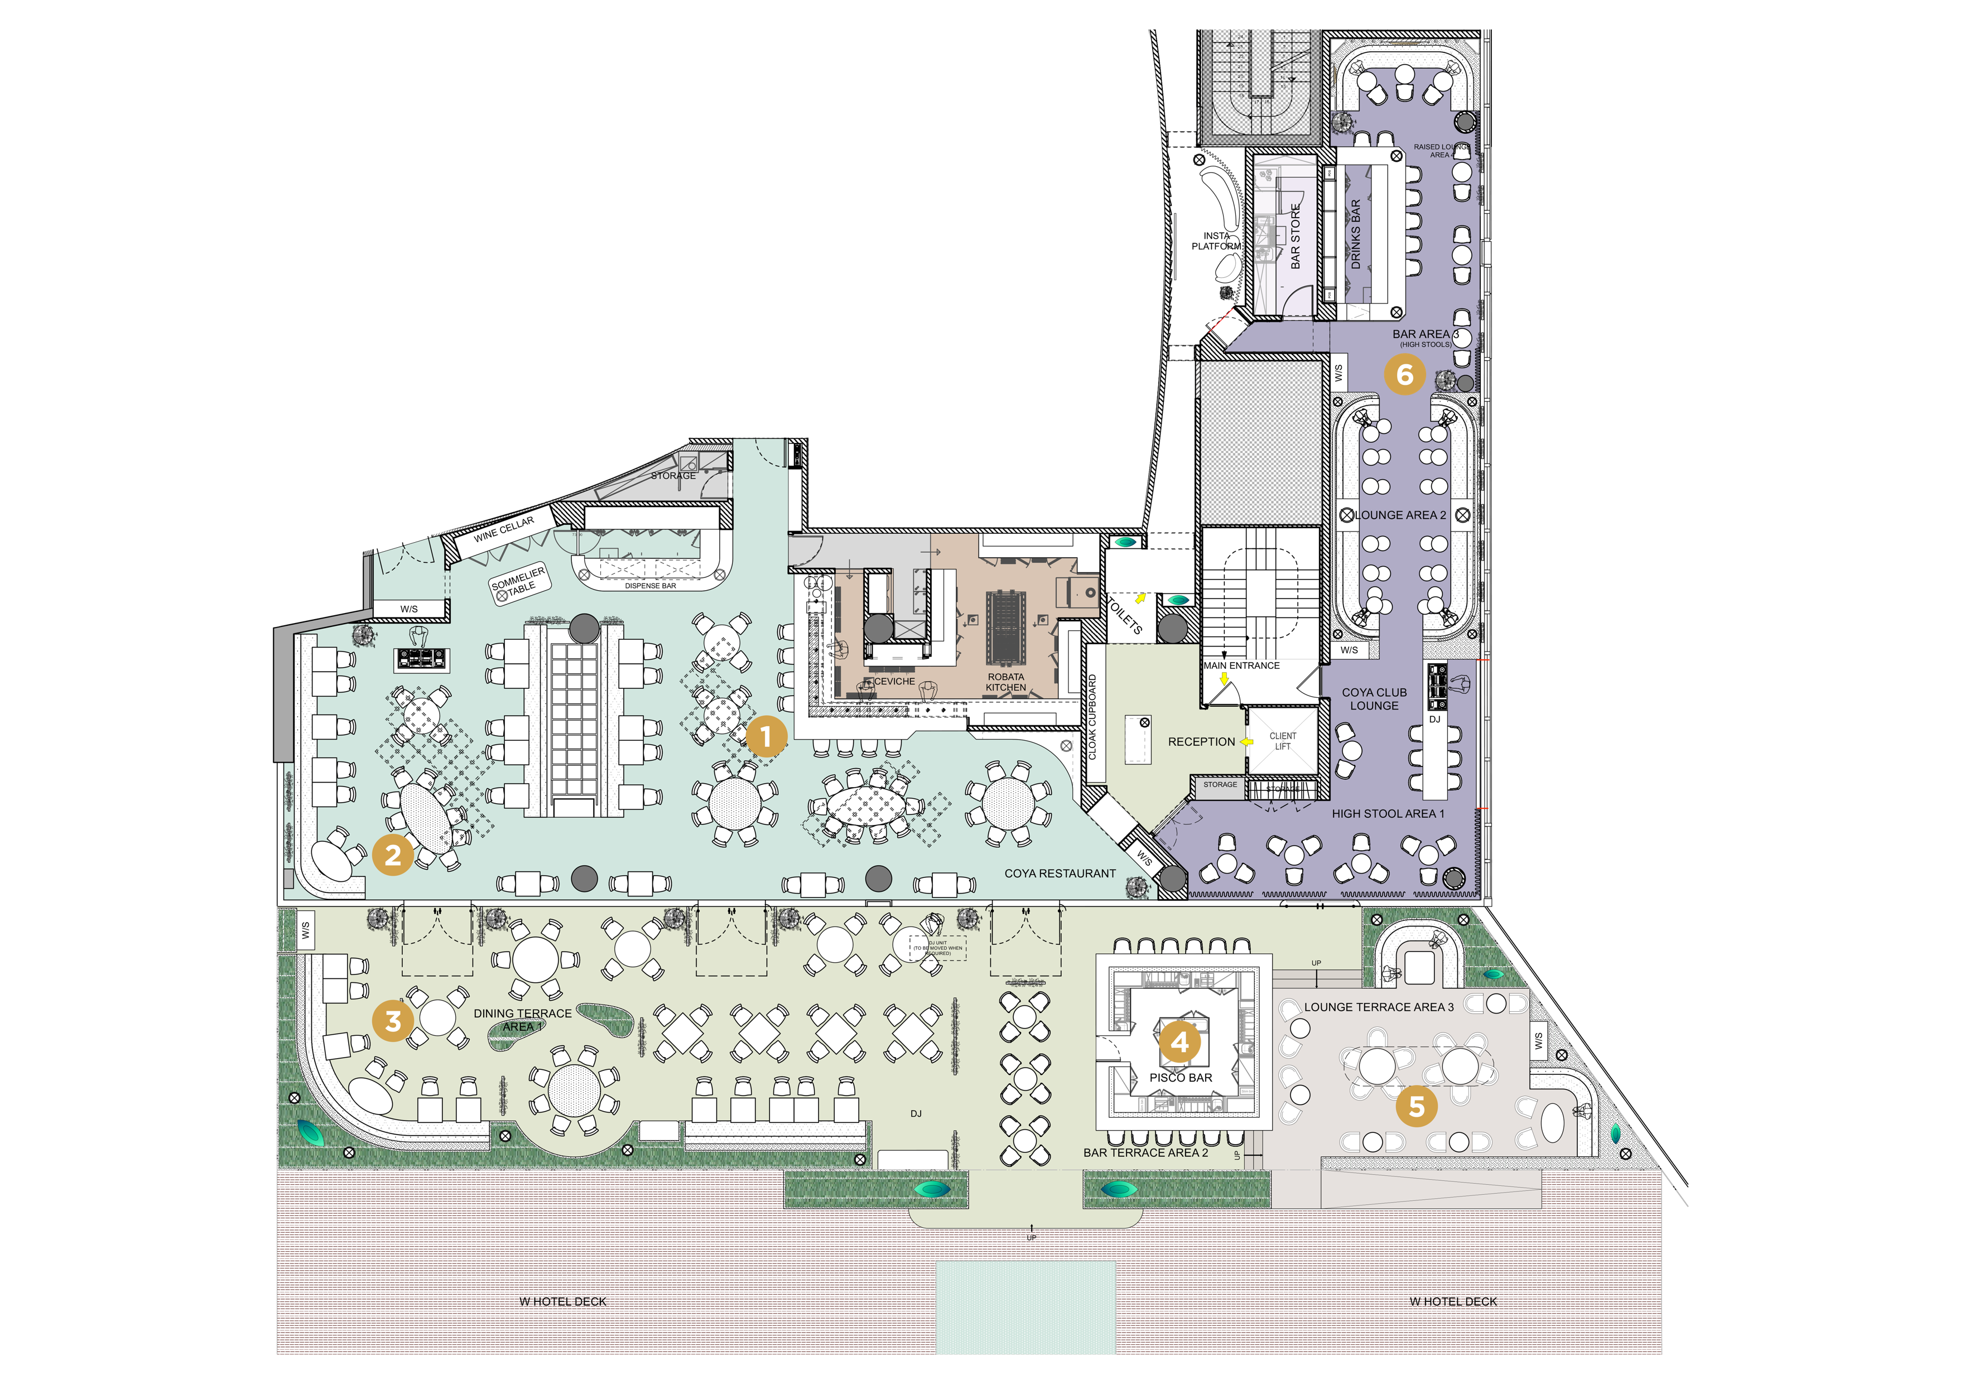
FLOOR PLAN & CAPACITY
Section Standing Seated
Indoor Main Dining Room
El Dorado
Dining (Terrace)
Bar (Terrace)
Lounge (Terrace)
Full Terrace
Pisco Bar Lounge
Full Hire (Apr to Oct)
Full Hire (Oct to Mar)
150
60
120
40
40
150
120
450
150
120
60
80
NA
30
120
60
250
150
Indoor Main Dining Room 1
El Dorado 2
Terrace Dining 3
Terrace Bar 4
Terrace Lounge 5
Pisco Bar Lounge 6
COYA 2012 - 2024. All rights reserved.

Slide 10
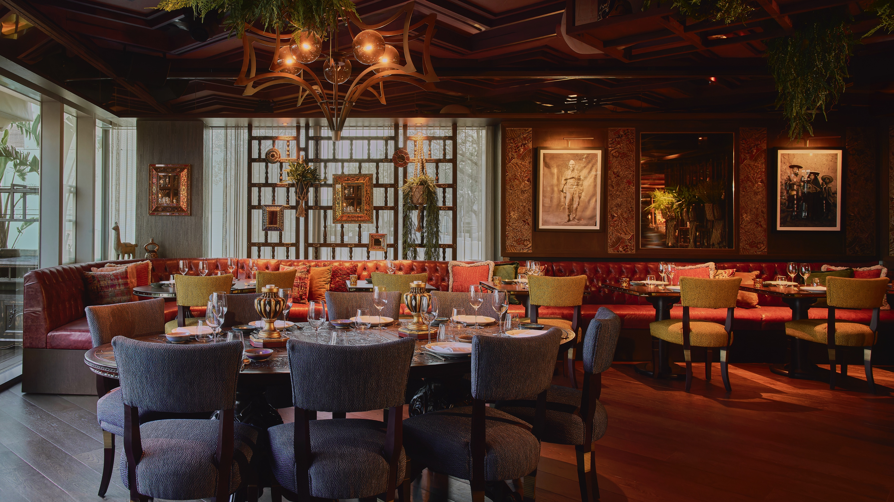
ADDITIONAL SERVICES
Enhance your experience at COYA Mayfair by adding one of our additional services to your upcoming event.
Custom menu & place cards
Flower arrangements & decorations
Day Delegate Packages
AV Facilities
Live entertainment (DJ or band)
Pisco masterclass
Exclusive venue hire

Slide 11
City of London - Mayfair - Paris - Dubai - Abu Dhabi - Riyadh - Doha
Mykonos - Marbella - Monte Carlo – Barcelona – Muscat
COYA BARCELONA
Plaça Rosa Del Vents 1, Final, Pg. de Joan de Borbó, 08039 Barcelona, Spain
+34 609 513 343 | events.bcn@coyarestaurant.com | www.coyarestaurant.com
Click here for a virtual tour of our venue.
COYA 2012 - 2024. All rights reserved.

